Slide 2
Objectives
List and explain text and font styles
Describe inline spans
Explain paragraph indentation and application of border
Explain horizontal paragraph alignment
Explain vertical spacing within a paragraph

Slide 3
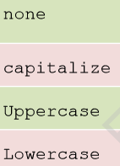
Text and Font Style
The text properties specify and control the appearance of the text in a Web page.
User can change the color of a text, increase or decrease the space between characters, align a text, and so on
^{left}
^{right}
^{center}
^{justify}
font-family
font-size
font-style
font-variant
color
text-align
text-decoration
text-indent
text-transform
word-spacing
^{none}
^{underline}
^{overline}
^{line-through}
^{blink}

Slide 4
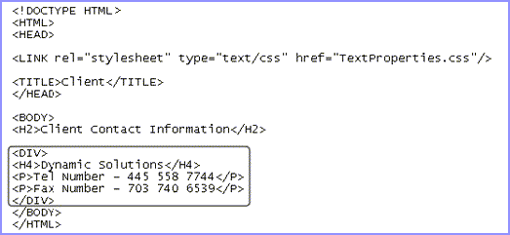
Text Styles 1-2
Following figure shows DIV element HTML code.

Slide 5
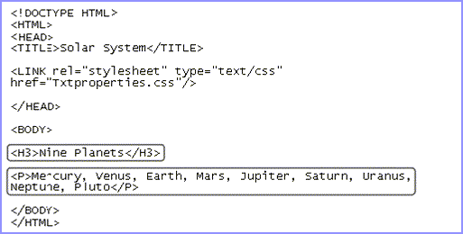
Text Styles 2-2
Following table lists the values assigned to the text-decoration property.

Slide 6
Inline Span
The <span> tag groups inline-elements in a document
For example, if one word in a sentence need to be bold or color without using the <b> tag or <font color=…> tag <p>My mother has <span style=‘color: blue; font-weight:bold’> blue</span> eyes. </p>
The <span> tag has different attributes; it supports JavaScript event attributes also

Slide 7
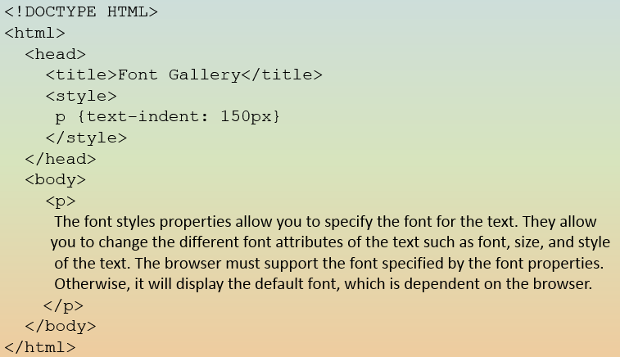
Indenting Paragraph 1-3
Indenting is the process of setting off the text from its normal position, either to the left or to the right.
In paragraph style, there are three types of indentation:
First line indent
The text–indent property is used to indent the first line of a paragraph
^{Inline Style}
^{<p style=”text-indent: 50px”>}
^{Internal CSS}
^{p {text-indent: 50px}}

Slide 8
Indenting Paragraph 2-3
Padding
The padding property is used to add a specified amount of space between the border of an element and its contents.
^{<!DOCTYPE HTML>}
^{<html>}
^{<head>}
^{<title>Font Gallery</title>}
^{<style>}
^{p {padding: 20px }}
^{</style>}
^{</head>}
^{<body>}
<p> The font styles properties allow you to specify the font for the text. They allow you to change the different font attributes of the text such as font, size, and style of the text. The browser must support the font specified by the font properties. Otherwise, it will display the default font, which is dependent on the browser.
^{</p>}
^{</body>}
^{</html>}
^{Inline style}
^{<p style=”padding: 20px”>}
^{Internal CSS}
^{p {padding: 20px}}

Slide 9
Indenting Paragraph 3-3
Margin
The margin property is used to add a specified amount of white space around an element, on the outside of the element.
^{Inline style}
^{<p style=”margin: 20px”>}
^{Internal CSS}
^{p {margin: 20px}}

Slide 10
Border Style 1-3
Borders are rectangular outlines that surround an element.
Borders present around text and an image emphasize the content inside the text box.
CSS border properties specify the style, color, and width of the border.
^{Property}
border-left-style
border-right-style
border-top-style
border-bottom-style
Value | Description
Dashed | It is used for specifying a dashed border.
Dotted | t is used for specifying a dotted border.
Double | It is used for specifying two borders.
groove | It is used for specifying a 3D grooved border.
Inset | It is used for specifying a 3D inset border.
outset | It is used for specifying a 3D outset border.
ridge | It is used for specifying a ridged border.
solid | It is used for specifying a solid border.

Slide 11
Border Style 2-3
Following figure shows an HTML code.
Following figure shows the output of border-style properties.

Slide 12
Border Style 3-3
Shorthand property
shorthand properties reduce the length of the code, make the code concise
Applies a 3D grooved border at the top, 3D inset border at the right, 3D outset border at the bottom, and dashed border at the left.

Slide 13
Border Color 1-3
The border-color property in CSS applies colors to all the four borders.
One can also apply four different colors to four borders.
border-bottom-color
border-left-color
border-right-color
border-top-color
The border-color property accepts different color values that determine the different shades of color to be applied to the borders.
^{color}
^{transparent}

Slide 14
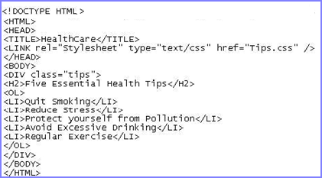
Border Color 2-3
Following figure shows an HTML code with properties.

Slide 15
Border Color 3-3
Shorthand property

Slide 16
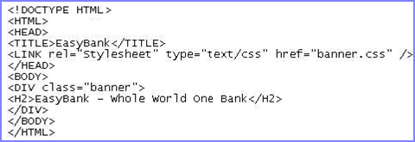
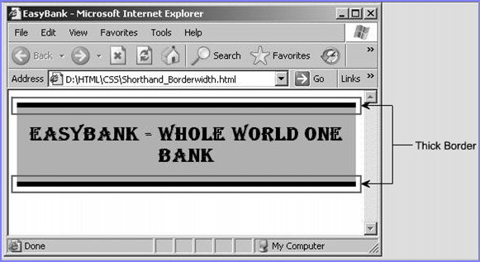
Border Width 1-2
specify the width for all the four borders.
allow to individually specify the left, right, top, or bottom borders.
^{Property}
^{border-bottom-width}
^{border-left-width}
^{border-right-width}
^{border-top-width}
^{Value}
^{medium}
^{length}
^{thick}
^{thin}

Slide 17
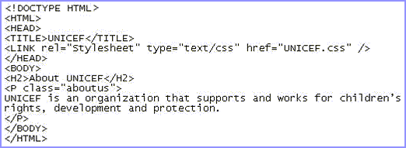
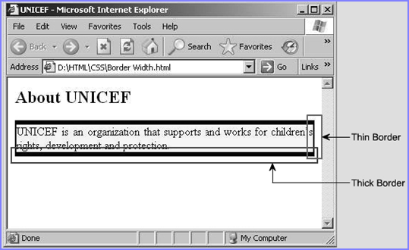
Border Width 2-2
Shorthand property

Slide 18
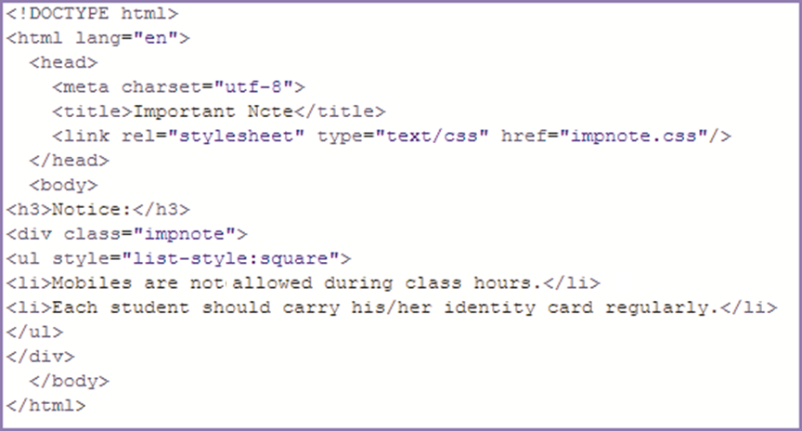
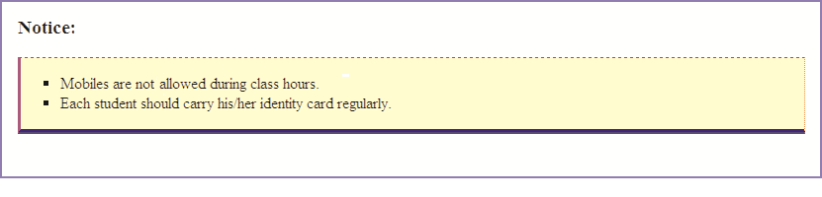
Shorthand Border 1-3
specifies all the properties such as style, width, and color for all the four borders.
^{Property}
border-bottom
border-left
border-right
border-top

Slide 19
Shorthand Border 2-3
Following figure shows CSS code of image border property.

Slide 20
Shorthand Border 3-3
border: solid thin #FF0000;
Specifies that all the four borders must be solid in style, thin by width, and red in color.

Slide 21
Horizontal Alignment
Text-align property is used for horizontal alignment of text in an element.
This property aligns the inline content of a block, applies only block level elements, such as paragraph.
^{Value} | ^{Description}
left | Aligns the text to the left. (default, applied for Western language),
right | Aligns the text to the right (Hebrew & Arabic languages).
center | Centers the text.
justify | Aligns text to both left and right margins by adding space between words (like in newspapers and magazines).
inherit | Specifies that the value of the text-align property should be inherited from the parent element.

Slide 22
Vertical Alignment
line-height property is used for vertical alignment of text in an element.
This property is also a component of the ‘font’ shorthand property.
It can be applied on block-level elements, table cells, table caption, and so on.
^{Value} | ^{Description}
normal | A normal line height. This is default.
number | A number that will be multiplied with the current font size to set the line height.
length | A fixed line height in px, pt, cm, and so on.
% | A line height in percent of the current font size.
inherit | Specifies that the value of the line-height property should be inherited from the parent element.

Slide 23
Summary
The text styles specify and control the appearance of the text in a Web page.
Indenting is the process of offsetting text from its normal position, either to the left or to the right.
Border property specifies the style, color, and width of the border.
The border-color property accepts different color values that determine the different shades of color to be applied to the borders.
Text-align property is used for horizontal alignment of text in an element.
Line-height property is used for vertical alignment of text in an element.
Notes:
Indenting : thut vao dau dong. Thut le.

